Slide 1
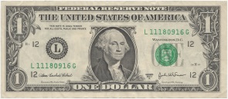
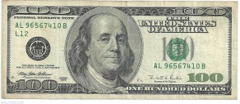
Bigger salary
A wise man should have money in his head, but not in his heart ― Jonathan Swift

Slide 2
Higher quality education
When you know better you do better ― Maya Angelou

Slide 3
Development of languages
The limits of my language are the limits of my world
‒ Ludwig Wittgenstein

Slide 4
Meeting new people and cultures
Everyone is a new universe to explore

Slide 5
Personal freedom
Freedom is nothing but a chance to be better ‒ Albert Camus

Slide 6
Getting used to new countries
All of life is a foreign country ‒ Jack Kerouac

Slide 7
Dissatisfaction of own country
Home is where the heart is ‒ Pliny the Elder

Slide 8
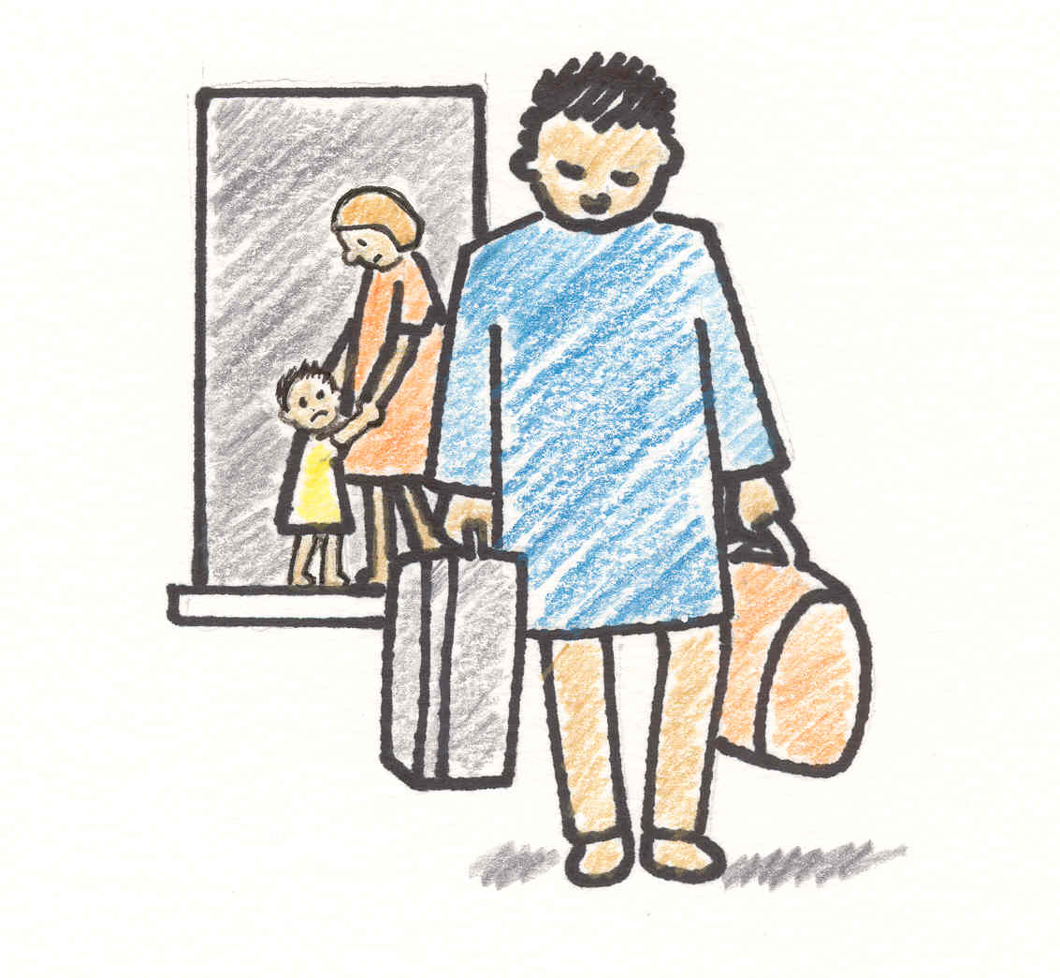
Disintegrated families
Family means no one gets left behind or forgotten ‒ David Ogden Stiers

Slide 9
Culture assimilation
Together we are different

Slide 10
Depopulation
If we travel to better country, who will make our home better?

