Slide 1
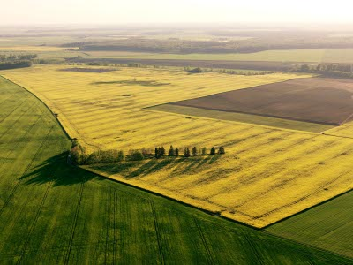
LITHUANIAN QUALITIES
LITHUANIA

Slide 2
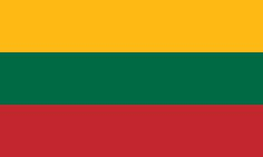
fields of ryes and wheats
life
shed blood for the Motherland

Slide 4
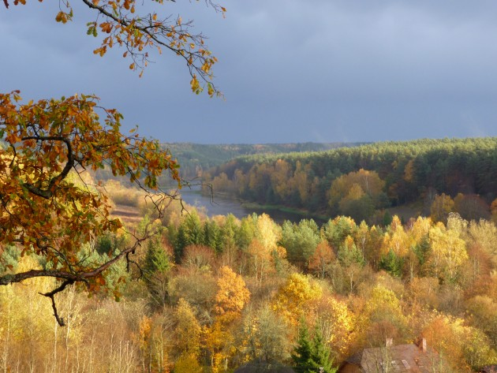
History
History
Lithuania has a very rich and worthy of pride history. During the 14th century, the Grand Duchy of Lithuania was the largest country in Europe : present-day Belarus, Ukraine, and parts of Poland and Russia were territories of the Grand Duchy of Lithuania.
Lithuania has a very rich and worthy of pride history. During the 14th century, the Grand Duchy of Lithuania was the largest country in Europe : present-day Belarus, Ukraine, and parts of Poland and Russia were territories of the Grand Duchy of Lithuania.

Slide 5
The Grandy Dutch of Lithuania in XIV.

Slide 6
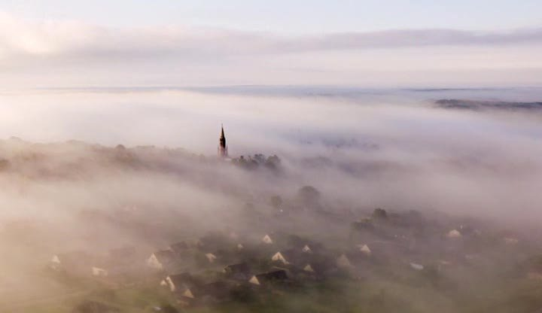
Independence
Independence
The biggest quality for lithuanians always has been an independence. All the time they were struggling with sweat and blood for it. Thousands of men died for the aim that their children would live in a freedom.
The biggest value for Lithuanians has always been an independence. All the time we had been struggling with sweat and blood for it. Thousands of men died for the aim that their children would live in freedom.

Slide 7
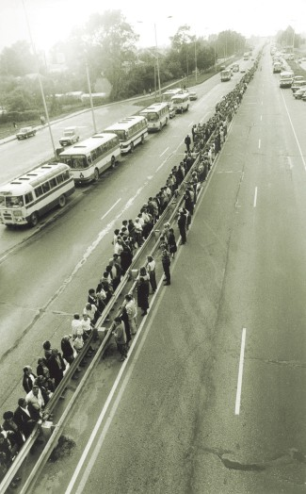
The Baltic Way or Baltic Chain was a peaceful political demonstration that occurred on August 23, 1989. Approximately two million people joined their hand to form a human chain spanning 600 kilometres (370 mi) across the three Baltic states.
The Baltic Way or Baltic Chain was a peaceful political demonstration that occurred on August 23, 1989. Approximately two million people joined their hand to form a human chain spanning 600 kilometers (370 mi) across the three Baltic states.

Slide 9
The events of January 13 in 1991 are sometimes referred to as Bloody Sunday. That night, after The Lithuanian Republic declared independence from the Soviet Union, soviet military attacked the capital of Lithuania with tanks and solders. But Lithuanians all like one defended the country.

Slide 10
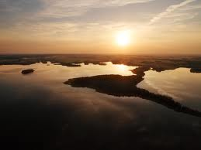
Language
Language
The Lithuanian language is believed to be the oldest living Indo-European language.
Lithuanian is very beautiful and assonant language. It causes so many amazing songs of Lithuania, which is called contractual.
The Lithuanian language is believed to be the oldest living Indo-European language.
Lithuanian is very beautiful and assonant language that is why we have so many amazing songs and one very specific kind which is typical only for Lithuanians. It is contractuals.

Slide 12
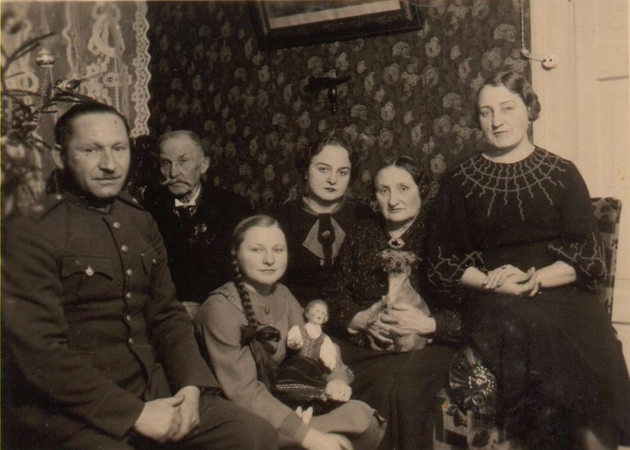
Traditions
Lithuanians have many traditions.
One of the most important is Christmas Eve. It’s the night before Christmas. All family members, even those who are far away come home to spend time together. But Christmas Eve is still evening of Advent, so it has to be spent calmly.
Also Chirstmas Eve has magical meaning, with different magical rituals. People predict their future, whether younger girls will get married in the next year, and if farmers will have a good harvest.

Slide 13
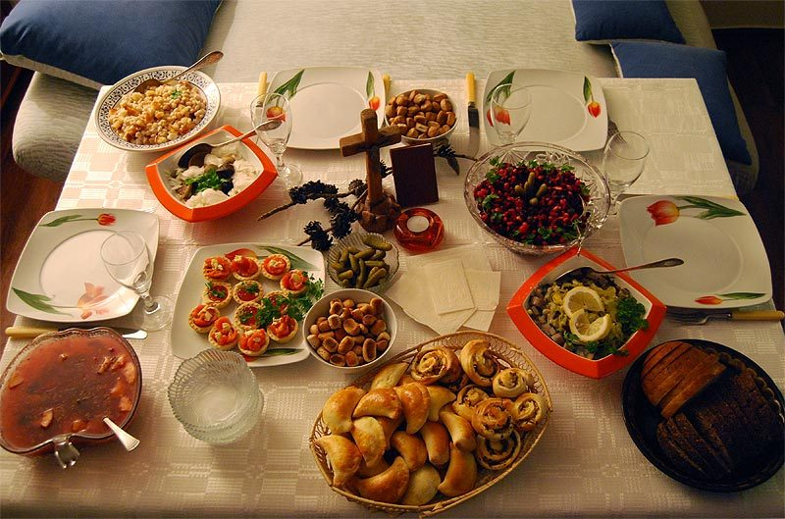
Christmas Eve dinner has to consist of 12 different dishes. They symbolise the 12 months of the year, and according to the Christian traditions the 12 Apostles of Jesus. All dishes have to be without meat, most popular is fish, herring, small Christmas Eve cookies with poppy milk, Lithuanian drink from cranberries, dried fruit soup, vegetable salad, mushrooms, boiled potatoes, sauerkraut, bread.
Christmas Eve dinner has to consist of 12 different dishes. They symbolise the 12 months of the year, and according to the Christian traditions the 12 Apostles of Jesus. All dishes have to be without meat, most popular is fish, herring, small Christmas Eve cookies with poppy milk, Lithuanian drink from cranberries, dried fruit soup, vegetable salad, mushrooms, boiled potatoes, sauerkraut, bread.

Slide 14
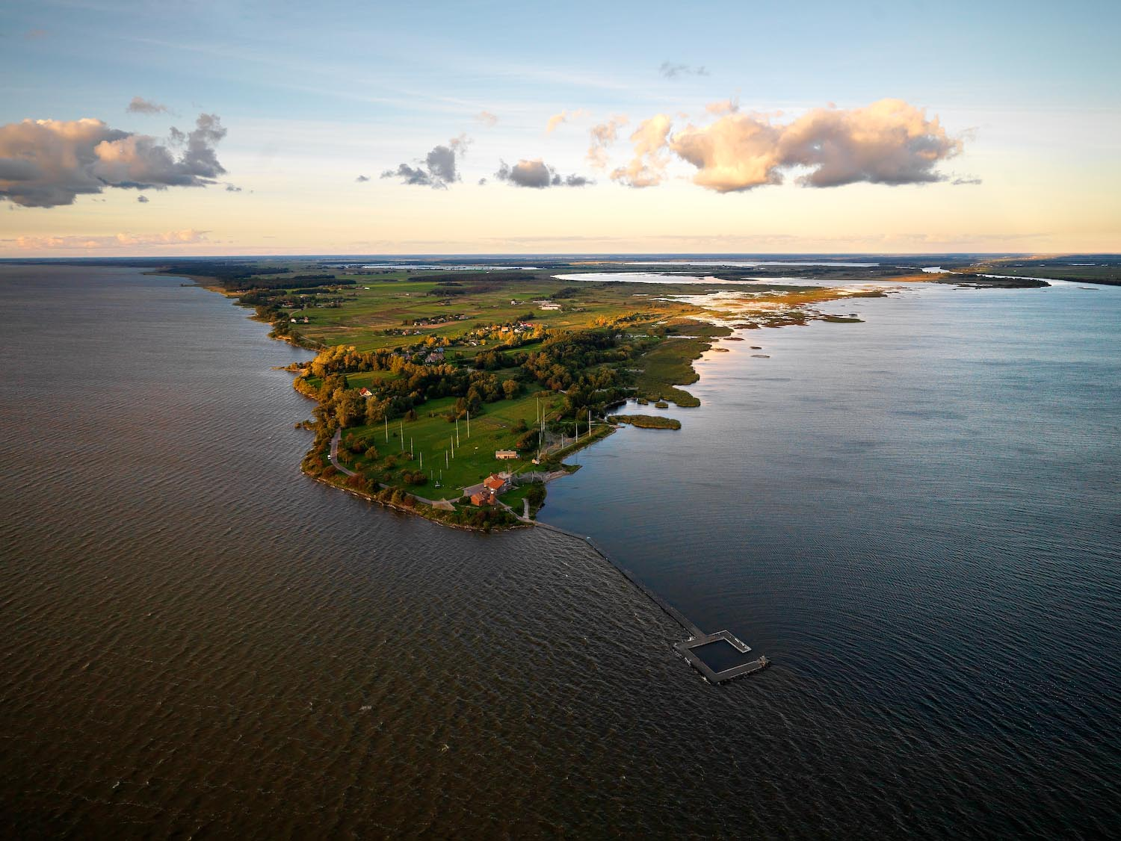
Nature
Nature
We have unbelievably wonderful nature: rivers, lakes, forests, Baltic sea. Lithuania is a amazing place in the world to be in a natural and intact countryside.
We have unbelievably wonderful nature: rivers, lakes, forests, the Baltic sea. Lithuania is an amazing place in the world if you want to be in natural and untouched countryside.

Slide 15
The Curonian Spit is a 98 km long, thin, curved sand-dune spit that separates the Curonian Lagoon from the Baltic Sea coast. It is a UNESCO World Heritage Site.

Slide 16
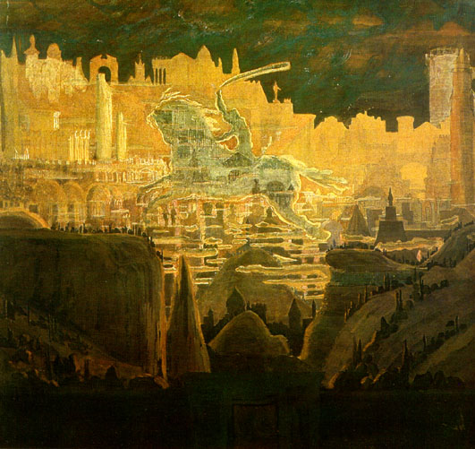
Lithuania by M. K. Čiurlionis.
Čiurlionis was the most famous Lithuanian painter and composer. He lived very short, but created about 300 incredible paintings and composed about 250 pieces of music.

Slide 17
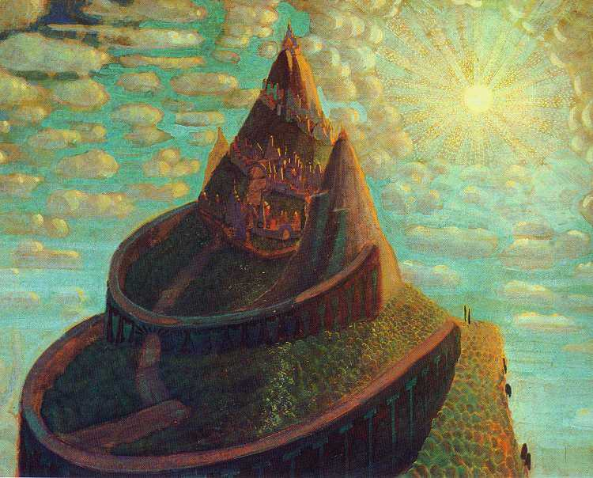
“Fairy Tale” 1909

Slide 18
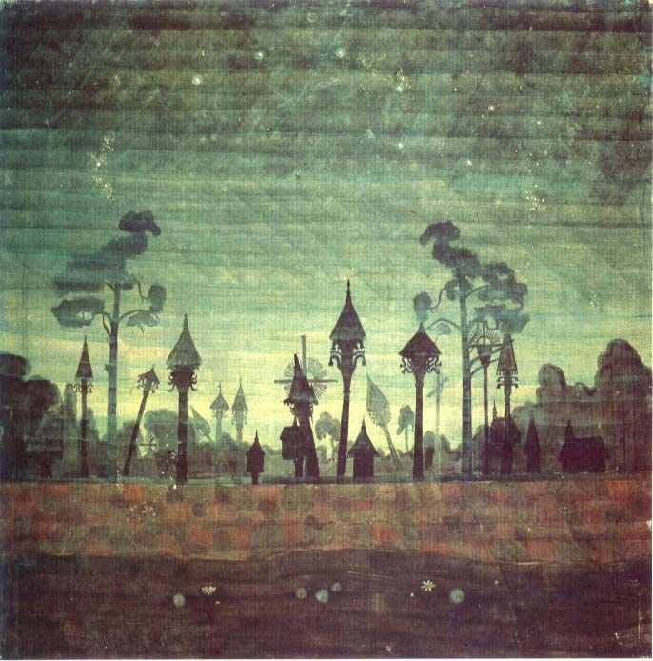
Thank you for your attention!

